Slide 1
Network Cloudification: Turning Communications into Computing with Software Defined Networking and Network Function Virtualization The 2nd Wave of Cloud Computing Is Turning Appliances to Apps.
Ying-Dar Lin
IEEE Fellow, IEEE Distinguished Lecturer, ONF Research Associate, Associate EiC of IEEE Computer
Distinguished Professor, National Chiao Tung University, Taiwan
Director, Network Benchmarking Lab
May 2016

Slide 2
林盈達 Ying-Dar Lin
B.S., NTU-CSIE, 1988; Ph.D., UCLA-CS, 1993
Distinguished Professor (2014~)/Professor (1999~2013)/Associate Professor (1993~1999), NCTU-CS; IEEE Fellow (2013~); IEEE ComSoC Distinguished Lecturer (2014&2015), ONF Research Associate (6/2014~)
Founder and Director, NCTU Network Benchmarking Lab (NBL; www.nbl.org.tw, ONF Approved Lab), 2002~
Editorial Boards: Associate EiC of IEEE Computer (2015~), IEEE Wireless Comm. (2013~), IEEE Transactions on Computers (2011~2015), IEEE Computer (2012~), IEEE Network (2011~), IEEE Communications Magazine – Network Testing Series (2010~), IEEE Communications Letters (2010~), Computer Communications (2010~), Computer Networks (2010~) , IEEE Communications Surveys and Tutorials (2008~), IEICE Transactions on Information and Systems (11/2011~)
Guest Editors of Special Issues: Traffic Forensics, IEEE Systems Journal, May 2015; SDN, IEEE Computer, Nov 2014; Multi-Hop Cellular, IEEE Wireless Communications, Oct 2014; Deep Packet Inspection, IEEE JSAC, Oct 2014; Mobile Application Security, IEEE Computer, June 2014; Open Source for Networking, IEEE Network, Mar&Sept 2014.
Founder and Director, III-NCTU Embedded Benchmarking Lab (EBL; www.ebl.org.tw), 2011~2015
CEO, Telecom Technology Center (www.ttc.org.tw), 7/2010~5/2011
Director, Computer and Network Center, NCTU, 2007~2010
Consultant, ICL/ITRI, 2002~2010
Visiting Scholar, Cisco, San Jose, 7/2007-7/2008
Director, Institute of Network Engineering, NCTU, 2005~2007
Co-Founder, L7 Networks Inc. (www.L7.com.tw), 2002
Areas of research interests
Software Defined Networking (SDN) & Network Function Virtualization (NFV)
Wireless communications: 5G, MEC, RAN sharing
Deep Packet Inspection
Attack, virus, bot, spam, porno, P2P
Software, algorithm, hardware, SoC
Internet security and QoS
Test technologies of switch, router, WLAN, security, VoIP, 4G/LTE, SDN, and smartphones
Publications
International journal: 112
International conference: 54
IETF Internet Draft: 1
Industrial articles: 170
Textbooks: 3 (Ying-Dar Lin, Ren-Hung Hwang, Fred Baker, Computer Networks: An Open Source Approach, McGraw-Hill, Feb 2011)
Patents: 31
Tech transfers: 8
Well-cited paper: Multihop Cellular: A New Architecture for Wireless Communications, INFOCOM 2000, YD Lin and YC Hsu; #citations: 700+; standardized into IEEE 802.11s, Bluetooth, WiMAX, and LTE

Slide 3
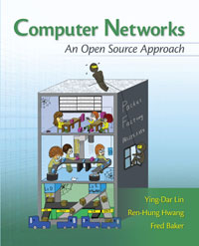
Ying-Dar Lin, Ren-Hung Hwang, Fred Baker, Computer Networks: An Open Source Approach, McGraw-Hill, Feb 2011.
www.mhhe.com/lin; available now at amazon.com
Facebook Q&A Communit: www.facebook.com/CNFBs
ISBN: 0-07-337624-8 / 978-007-337624-0
Computer Networks: An Open Source Approach considers why a protocol, designed a specific way, is more important than how a protocol works. Key concepts and underlying principles are conveyed while explaining protocol behaviors. To further bridge the long-existing gap between design and implementation, it illustrates where and how protocol designs are implemented in Linux-based systems. A comprehensive set of fifty-six live open source implementations spanning across hardware (8B/10B, OFDM, CRC32, CSMA/CD, and crypto), driver (Ethernet and PPP), kernel (longest prefix matching,
checksum, NAT, TCP traffic control, socket, shaper, scheduler, firewall, and VPN), and daemon (RIP/OSPF/BGP, DNS, FTP, SMTP/POP3/IMAP4, HTTP, SNMP, SIP, streaming, and P2P) are interleaved with the text.
3

Slide 4
Outline (1/2)
Overview Why SDN and NFV How to SDN and NFV Where and when to SDN and NFV Market forecast Research Survey My research roadmap Standardization Basic SDN architecture Related standards Introduction to OpenFlow Extended SDN architecture with NFV | Development Resources for developers Data plane Control plane Introduction to RYU Routing in SDN Management plane Introduction to OpenFlow extension Case study: Campus Wi-Fi SDN solution Functional specification Architecture design

Slide 5
Outline (2/2)
Testing Resources for testers Testing tools Test items and methodologies Case study: SDN conformance test | Lessons Learned References

Slide 6
Overview

Slide 7
Why SDN and NFV?
2nd wave of cloud computing
1st wave to servers: centralized and virtualized
NaaS (Networking as a Service)
From operators to enterprise and residential subscribers
Turning appliances to apps
Virtues
Reduced CAPEX (simpler devices) and OPEX (fewer administrators)
Fast service orchestration (centralized programmability)

Slide 8
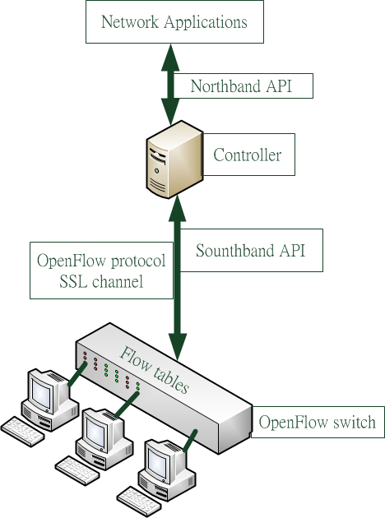
But How To Centralize Networking?
Centralized control and management planes
At controllers (basic connectivity) and applications (advanced services)
Control and manage data plane at switches
Southbound API between controllers and switches: OpenFlow over SSL
Northbound API between controllers and applications

Slide 9
SDN versus Traditional (1/2)
Control-Plane: routing
 | Traditional network |  | SDN
Computation | OSPF | RIP | LLDP + OpenFlow Flow_modify
 | Link state | Distance Vector | LLDP Message
 | Dijkstra algorithm | Bellman-Ford algorithm | Any (e.g. Dijkstra algorithm)
Topology information | Global /Distributed | Partial /Distributed | Global, partial /Centralized
Link failure handling | Flood the link states | Exchange the distance vectors | Switch sends port-status to controller Controller updates the partial topology
Congestion handling | Flood the link states | Exchange the distance vectors | Wait for next interval to update routing path

Slide 10
SDN versus Traditional (2/2)
Management-Plane
 | Traditional network | SDN
Management information | Centralized | Centralized
Access method | SNMP | OpenFlow protocol and OF-CONFIG
Control level | Limited (e.g. can’t modify the routing table) | Unlimited (e.g. can modify the routing table)
Information usage | Management-plane | Control-plane & Management-plane

Slide 11
Too Primitive? Basic SDN to Extended SDN by NFV
To extend data plane
Network Function Virtualization (NFV)
To run new services on appliances or VMs
To extend control plane for the extended data plane
Service Chaining (SC) at applications
To decide service path
Network Service Header (NSH) onto switches
To program service path

Slide 12
Where and When to SDN-NFV?
Data centers: since late 2000s
Operators: NaaS
Enterprises: service trials from 2014/2015
Residential: after 2017?
Wireless: after 2018? (small cells in 5G, HetNet in 4G)
Cloud-RAN (Radio Access Network)
Mobile and M2M: after 2020?

Slide 13
Driving Force on Operators
Challenges faced by all Communications Service Providers (CSPs)
Rapid mobile traffic growth, especially video content
Network cost is going to surge while revenue is steady…
Source: SNS research
CAPEX /OPEX surges due to boosted data traffic demand and 4G investment
Need to control network cost while boosting new service revenue

Slide 14
Revenue Generation based on the Forecasted Fast-growing of SDN-enabled Industry
SDN market value will hit US$36.3B by 2018 with a CAGR of 75%.
A visible ceiling in hardware market is a huge threat to Taiwan ICT industry.
If TW can gain 10% of market share, the revenue generation will be US$3.63B (NT$108.8B), even 5% will be US$1.28B (NT$54.4B).
Source: SNS research

Slide 15
SDN Market Forecasts
Global SDN sales by user base (2010-2020)
Global service provider SDN & NFV revenue by functional area (2020)
Source: SNS Research

Slide 16
SDN in Taiwan – SNS Forecast
Asia Pacific is the biggest market driver for SDN growth
SNS forecasts Taiwan SDN & NFV sales to enjoy a similar growth pattern as other Asian countries does as Pakistan, Thailand, Indonesia, Philippines and Singapore.

Slide 17
Research

Slide 18
Survey: Correctness and Conformance
Issue | Layer | Type of verification | Ref
Correctness of flow entry | Infrastructure layer | Run time verification | [1]
 |  | Offline verification | [2],[3]
Network correctness | Control and Infrastructure layer | Algorithm for verification | [4],[5]
 |  | Offline test | [6],[7]
Policy correctness | Application and control layer | Algorithm for verification | [8],[9]
 |  | Run time verification | [10]
Policy update correctness | Application, control and Infrastructure layer | Verification of updates | [11],[12]

Slide 19
Survey: Performance and Scalability
Issue | Sub issue | Solution | Require modification | Ref
Lookup procedure | Flow table size Lookup procedure CPU power | Implement Full line-rate switch on NetFPGA | Switch hardware | [13]
 | CPU power | Network processor acceleration card | Switch hardware | [14]
 | Software base lookup procedure | By caching table entry on network interface card | Switch hardware | [15]
Switch resources utilization | Flow table size CPU power | Multi-core | Switch hardware | [16]
 | Buffer size CPU power | High-bandwidth internal link | Switch hardware | [17]
 | Flow table size | Algorithm for rules placement | Rule placement algorithm | [18]
Notes:
Switch resources utilization

Slide 20
Survey: Security [19]
Solution to Security issue | SDN layer |  |  | Ref
 | App | Control | Data
Unauthorized Access |  | O |  | [20]
 | O |  |  | [21]
 | O | O |  | [22]
 | O | O | O | [23]
Malicious Applications | O | O |  | [24] [25]
Denial of Service |  | O | O | [26]
 | O | O | O | [27] [28]
Conﬁguration Issues | O |  |  | [29]
 | O | O |  | [30] [31] [32]
 | O | O | O | [33] [34] [35]
 |  | O |  | [36]
System Level SDN Security | O |  |  | [37]
 | O | O |  | [38]

Slide 21
Survey: Use Cases
Case | Benefits | Ref
Cloud | Large in scale Cost-effective Easy to operate | [39] [40]
Mobile | Speed up the deployment of new solutions | [41][42]
ICN (Information content network) | Easy to deploy | [43][44]
Network function virtualization | Reduce deployment time Allow service scale up and down Create new virtual applications | [45]
Network virtualization | Customize virtual network | [46]
Security | Controller security Northbound interface security | [47][48]

Slide 22
My Works on SDN/NFV
Services
Lead guest editor, 1st SI on SDN, IEEE Computer, Nov 2014.
Publicity co-chair, 1st IEEE Conference on NFV-SDN, Nov 2015.
Guest editor, SI on SDN-NFV Security, IEEE Comm. Mag., submitted.
Standard contributions
ONF Research Associate, June 2014 ~
5th ONF approved test lab (Network Benchmarking Lab, NBL), July 2014 ~
ONF OpenFlow 1.3.4 Conformance Test Plan, June 2015
ONF OpenFlow Switch Performance Test Plan, in preparation
Development
SDN campus Wi-Fi solution: licensed to Chunghwa Telecom
Research
Virtualized control plane: SDN track
Virtualized data plane: NFV track

Slide 23
IEEE Computer Special Issue on SDN Standardization, Nov 2014
Title | Authors | Organization | Issues
The Evolution of SDN and OpenFlow: A Standards Perspective | Sujata Banerjee Puneet Sharma Jean Tourrihes Justin Pettit | HP Labs VMware | OpenFlow evolution
Team of Rivals: Aligning Technology & Market Drivers in an Open-Source Standards | Rick Bauer Ron Milford Li Zhen | ONF InCNRTE BII | Testing programs
Network Functions Virtualization in Home Networks: A Test Lab Perspective | Marion Dillon Winter | Timothy UNH/IOL | NFV for home networking
Service Function Chaining: Network Service Header | Paul Quinn, Jim Guichard | Cisco | Service chaining by NSH
When Open Source Meets Network Control Planes | Christian Esteve Rothenberg Roy Chua Josh Bailey Martin Winter Carlos Correa Sidney C. de Lucena Marcos Rogério Salvador | UNICAMP SDNCentral Google NetDEF UFF UNIRIO Lenovo Innovation Center Brocade | Open source resources, APIs, and a case study RouteFlow

Slide 24
Multi-Path Routing for Failures and Congestion (1/2) Fast Failover
Computing multiple paths for each pair of subnets
Installing flow and group entries proactively
“fast failover” group entry
IP/mask
BP_{ad}
BP_{bd}
packet
port2
port1
port2
AP_{ad}
port1
Match
Instruction
port1
IP/mask | Group1
port2
BP_{cd}
Gid Type Action buckets
1 | fast failover | Output 1, Output 2
Y. D. Lin, H. Y. Deng, C. R. Hsu, C. C. Liao, Y. C. Lai, “Fast failover and switchover for link
failures and congestion in software defined networks,” IEEE ICC, May 2016.

Slide 25
Multi-Path Routing for Failures and Congestion (2/2) Fast Switchover
Monitoring port status periodically
Switching flows to another path to resolve network congestion
IP1/mask1
IP2/mask2
packet
Flow switchover
BP_{be}
packet
port1
port2
port2
AP_{ad}
port1
port1
Match
Instruction
congestion
Controller detects
IP1/mask1 | Group1
IP2/mask2 | Group2
Gid Type Action buckets
1 | fast failover | Output 1, 2
2 | fast failover | Output 1, 2
Output 2, 1

Slide 26
An Extended SDN Architecture for Network Function Virtualization
Extended components:
two-layer traffic classification in the data plane
extended OpenFlow protocol messages
service chaining mechanisms
Y. D. Lin, P. C. Lin, C. H. Yeh, Y. C. Wang, Y. C. Lai, “An extended SDN architecture for network function virtualization with a case study on intrusion prevention,” IEEE Network, Special Issue on NFV-SDN, May 2015.

Slide 27
Case Study Extended Messages for Intrusion Detection

Slide 28
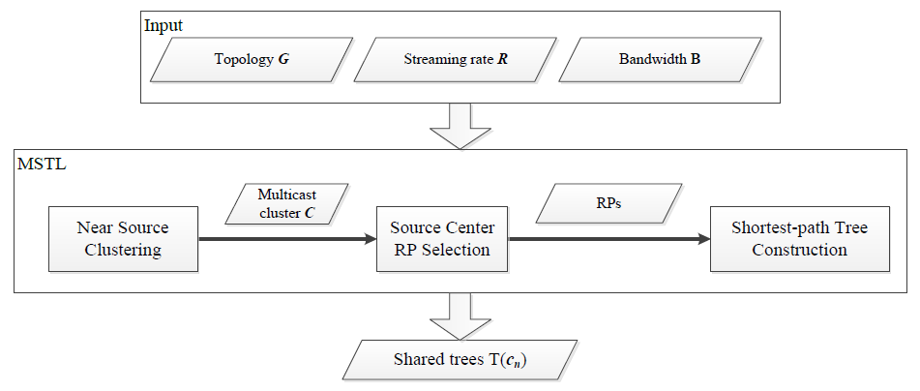
SDN Multicast with Multiple Shared Trees
Building multi-group shared trees to reduce control-plane and data-plane overheads
Given 100 multicast sources, only 2-6 shared trees are built
The computation time is less than 100 ms and 4% flow entries of per-source tree are installed
Ying-Dar Lin, Hung-Yi Teng, Chun-Chieh Liao, Yi-Chih Kao, and Yuan-Cheng Lai, “Scalable multicasting with
Multiple shared trees in software defined networks,” Journal of Network and Computer Applications, revised.

Slide 29
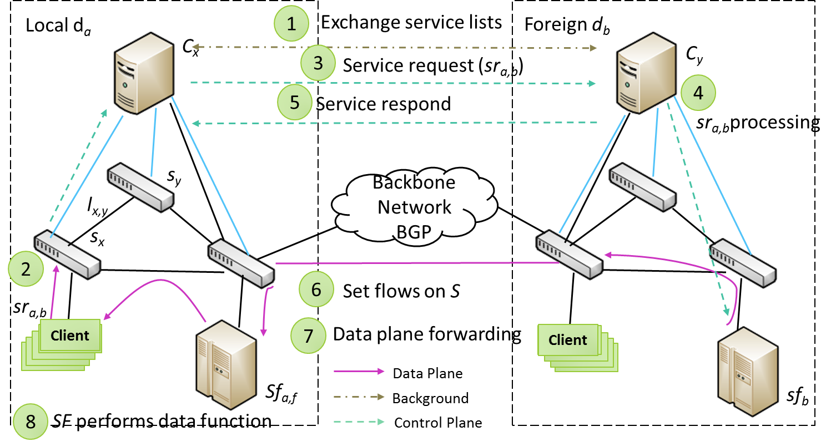
Cross-Domain SDN Service Extension
How controller architectures affect the performance of inter-domain service extension?
Multi-controller architectures can reduce the initial latency and the processing time because requests can be handled in parallel

Slide 30
SDN Wi-Fi Load Balancing
Two-tier architecture
Controller decides up to which load level APs accept association requests
Re-association time reduced by 28% to 36%, compared to purely centralized
Load balance improved by 34% to 41%, compared to purely distributed
Ying-Dar Lin, Chih-Chiang Wang, Yi-Jen Lu, Yuan-Cheng Lai, His-Chang Yang, “Two-tier dynamic load balancing in
in SDN-enabled Wi-Fi networks,” submitted to Wireless Networks.

Slide 31
SDN-NFV Balanced Service Chaining and Traffic Steering (1/2)
Balanced service chaining on the data plane without resorting to the controller: Packet-In’s reduced by 92.5%, within 5% of perfect balance
Leverages the OpenFlow group table with the SELECT type according to the hashing-based selection algorithm
Po-Ching Lin, Ying-Dar Lin, Cheng-Ying Wu, Yuan-Cheng Lai, Yi-Chih Kao, Balanced Service Chaining with Traffic Steering in Software Defined Networks with Network Function Virtualization, IEEE Computer, to appear.

Slide 32
SDN-NFV Balanced Service Chaining and Traffic Steering (2/2)

Slide 33
Joint Server and Network Load Balancing for NFV
Joint optimization vs. separate optimization
2-phase algorithm: Nearest First Local-Global Transformation (NF-LGT) (greedy + improvement)
Utilization improved by 45%, compared to separate optimization
Minh-Tuan Thai, Ying-Dar Lin, Yuan-Cheng Lai, “A joint network and server load balancing algorithm for
chaining virtualized network functions,” IEEE ICC, May 2016.

Slide 34
On-going Research Roadmap
Virtualized control plane (without NFV)
SDN Wi-Fi - /w NBL
SDN ONF performance test suite: switch, controller, app - /w ONF
SDN inter-datacenter multi-path load balancing - /w CHT
Hybrid SDN optimization: cost vs. coverage - /w NCU
Soft partition in SDN virtual networks – /w CHT
Intelligent/Cognitive routing - /w CHT
Virtualized data plane (with NFV)
NFV joint server and network load balancing – /w Mediatek
Control plane → data plane
Optimizing service chains in NFV – in-house
Hierarchical NFV data centers
Architecture design - in-house
Optimization – multi-party
Modeling - open
MEC (Mobile Edge Computing): vCPE & vEPC - /w ITRI & EU partners
Modeling and analysis
Modeling SDN-NFV - /w Wellington, NZ
Modeling TCP and UDP over SDN - /w Bangladesh

Slide 35
Standardization

Slide 36
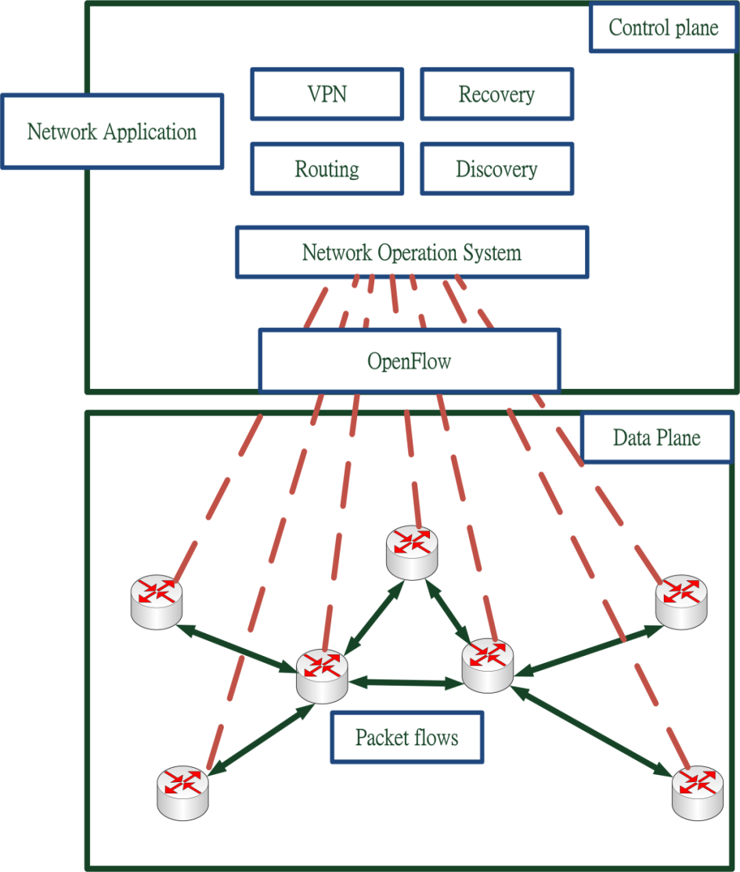
Basic SDN Architecture
Separated to control plane and data plane. Control plane: Network Application Data plane: switches only need to forward the packets Network applications can control switches through OpenFlow protocol.

Slide 37
Related standards
 |  | Spec/ Framwork | Routing | Management | Traffic | Virtualization
ONF | OF 1.3 | O
 | OF-Config |  |  | O
ETSI | NFV |  |  |  |  | O
IETF | ForCES | O
 | ALTO |  |  |  | O
 | SDN Bof | O
 | I2RS |  | O
 | NSH |  | O |  | O
IRTF | SDNRG | O
ITU-T | Y.FNsdn | O
 | Y.FNsdn-fm | O

Slide 38
Introduction to OpenFlow

Slide 39
OpenFlow tables
Flow Table 0
Flow Table 1
Flow Table 2
Execute action set
Meter table 0
Group table 0
Type | Functionality | From
Flow table | Routing | Pipeline
Group table | Do a set of actions Load balance | Call from flow table
Meter table | Limit bit rate | Call from flow table

Slide 40
Example – flow table
Action set can be used for transmit parameters between tables
match | instructions
A | Apply output 2 push-vlan 6 Goto-table 7
B | Apply output 2 Apply output 4 Goto-table 7
C | Meter 1 Goto table 7
D | Apply group 1 Write-output 2
match | instructions
A | Write output 3
B | Clear Write output 6
D | Goto table 9
* | Write output CONTROLLER
B’s Action={drop}
Output packets to port 4
Table7
Go to meter table 1
Table0

Slide 41
Example – group table
match | instructions
A | Apply group 1 Write-output 2
B | Apply group 2
C | Apply group 3
D | Apply group 4
gid | type | action buckets
1 | All | Output 3 (watch_port 3) Output 4 Output 5 (watch_port 5)
2 | Select | Output 3 (weight=10) Output 4 Output 5 (weight=20)
3 | Indirect | Output 3 Output 4
4 | Fast failover | Output 3 (watch_port 3) Group 1 (watch_group 1) Group 5 (watch_group 5)
5 | Fast failover | Group 4 (watch_group 4) Output 4 (watch_port 4)
Table0
Choose action buckets by algorithm
Only can have one action bucket
Group table
Choose first live action bucket
Notes:
Note
1.在group table 裡 ，有四種挑選 action buckets的方式 分別為 ALL ，select，indirect，fast failover

Slide 42
Example – meter table
packet C
(in_port=1)
match | instructions
A
B
C | Meter 1 Goto table 7
D
Meter ID | Meter Bands | Counters
1 |  | 8
2 | … | …
Band Type | Rate | Counters | Type specific arguments
Drop | 50 KB/s | 5
DSCP remark | 10 KB/s | 2
Drop | 30 KB/s | 1
packet C
port 1
rate=40 KB/s
Table0
Meter table
If packet rate over 30KB/s, packetes will be drop

Slide 43
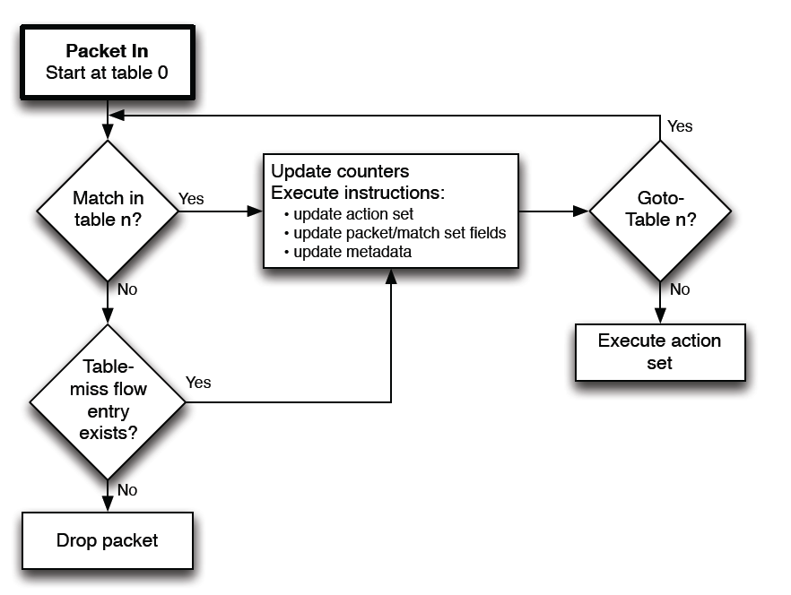
Matching Behavior
incoming

Slide 44
OpenFlow Messages (1/2)
Messages | Function | Direction | When to use
Hello | 1.Exchange between the switch and controller when connection startup | Two-way | Set up connection
Echo | 1.To verify the aliveness of connection 2.To measure the latency of connection | Two-way | Check aliveness Measure latency
Features | 1.Get identity 2.Get basic capabilities | Controller to switch | Get switch’s information
Configuration | 1.Get configuration 2.Set configuration | Controller to switch | Get switch’s information Set switch’s information
Read-State | 1.Get configuration 2.Get statistics 3.Get capabilities | Controller to switch | Get switch’s information
Modify-State | 1.Add entries 2.Delete entries 3.Modify entries | Controller to switch | Manage switch’s tables

Slide 45
OpenFlow Messages (2/2)
Messages | Function | Direction | When to use
Flow-removed | Inform the controller about the removal of a flow entry | Switch to controller | Flow be removed
Port-status | Inform the controller about the change on a port | Switch to controller | Port state change
Packet-In | 1.Packets forwarded to controller | Switch to controller | Table miss occur
Packet-Out | 1.After controller add list of action, send packet-out back to switch 2.If list of action is empty, drop the packets | Controller to switch | Reply packet-in request

Slide 46
OpenFlow 1.0 VS 1.3
Version | Add function
OpenFlow version 1.1 | Multiple Tables Groups MPLS & VLAN
OpenFlow version 1.2 | IPv6 support added Controller role change mechanism
OpenFlow version 1.3 | Per flow meters Per connection event filtering Auxiliary connections Tunnel-ID metadata Cookies in packet-in

Slide 47
Extended SDN Architecture
Control plane
Service Chaining (SC)
Data plane
Network Function Virtualization (NFV)
Interface between control plan and data plane
Traffic steering by Network Service Header (NSH)

Slide 48
Extended SDN Architecture (1/3)
Controller
redirected
Control plane
Control plane
OpenFlow
OpenFlow
Application Service
(FW, IDP, CF, WAF, AV)
redirected
redirected
Control plane
Control plane
Flow table
Flow table
Flow engine
Flow engine
Data plane
Data plane
OpenFlow switch
OpenFlow switch
Solution: Data plane and control plane extend to Service Chaining (SC) and Network Function Virtualization (NFV).

Slide 49
Extended SDN Architecture (2/3)
Controller
Northbound
SC API
Control plane
Control plane
SC
Application Service
(FW, IDP, CF, WAF, AV)
OpenFlow + Southbound NFV API
OpenFlow + Southbound NFV API
NSH Config.
NSH Config.
Control plane
Control plane
NFV
Flow table
Flow table
Flow engine
Flow engine
Data plane
Data plane
redirected
OpenFlow switch
OpenFlow switch
Notes:
opNFV
Etsi NFV
ONF L4 – L7

Slide 50
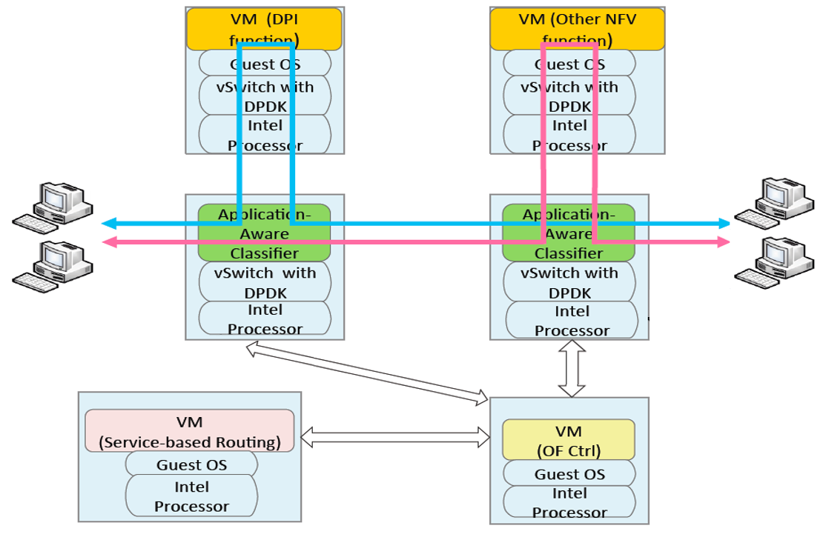
Extended SDN Architecture (3/3)
Extended Data Plane
DPI
Other NFV application
NFV
NFV
Data Plane
Switch
Switch
Extended Control Plane
OpenFlow + Southbound NFV API
Control Plane
Northbound
SC API
Service Chaining
OpenFlow Controller

Slide 51
Development

Slide 52
Resources for Developers
Topic | Purpose | Installation | Guide
Ryu | Controller | Ryu install [49] | Ryu API [50]
Ryu GUI |  | Ryu GUI install [51] | Ryu gui [52]
Ofsoftswitch | Software openflow switch | Ofsoftswitch install [53] | -
Mininet | Simulator | Mininet install [54] | Mininet tutorial [55]
Add experimenter message | Design openflow experimenter message | Environment setup [56] | Ofsoftswitch dev.doc
Horst | Spectrum analyzer for Wi-Fi | Horst install [57] | Horst guide [58]
simple_switch_igmp.py | Multicast controller module | Install in ryu | -

Slide 53
Data Plane
Intel DPDK
NTT Lagopus

Slide 54
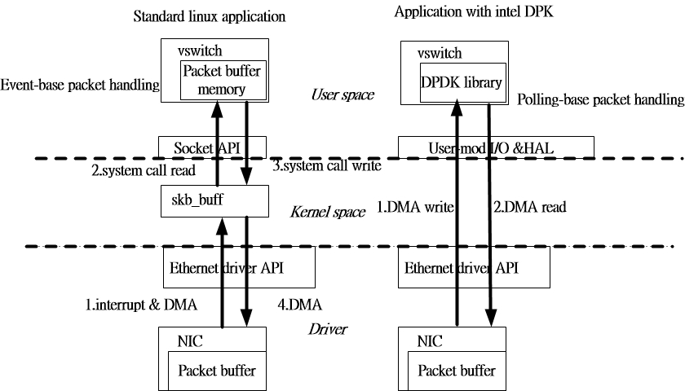
DPDK (standard vs DPDK)

Slide 55

Lagopas
Lagopus switch is a high-performance software OpenFlow 1.3 switch.
High performance software data plane with Intel DPDK

Slide 56
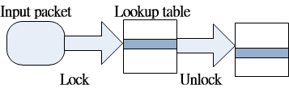
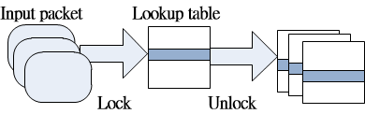
Lagopas (packet batching)
Native implementation (lock is required for each packet)
Packet batching implementation (Lock can be reduced due to packet batching)

Slide 57
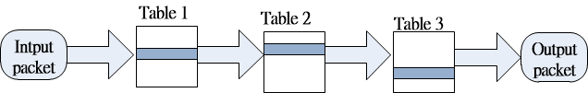
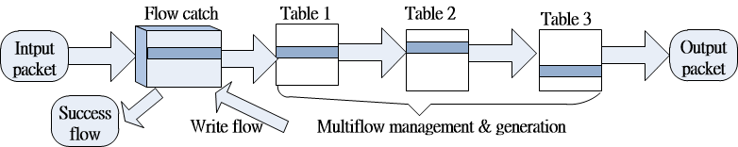
Lagopas (flow cache)
Native implementation
Lagopas implementation

Slide 58
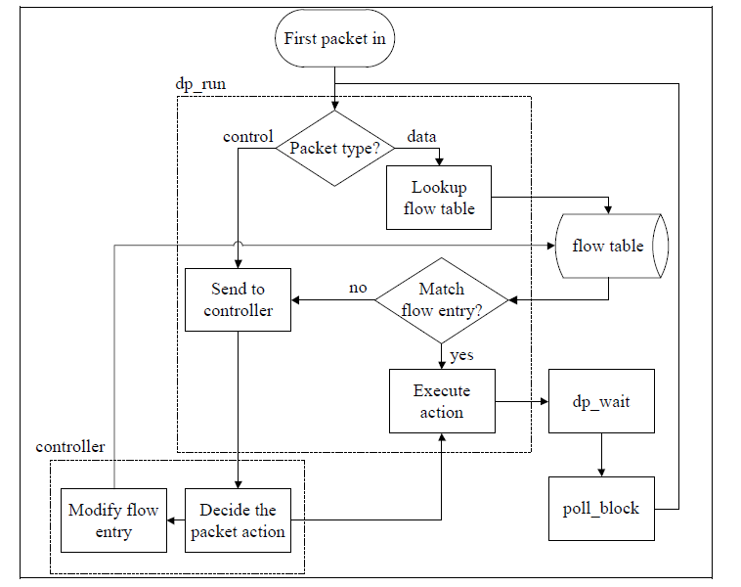
Data Plane within Open vSwitch
udatapath.c

Slide 59
Control Plane
Controllers
Routing
RouteFlow

Slide 60
Comparison on Controllers (Ryu, NOX, POX, Floodlight, OpenDayLight, ONOS)
Controller | routing method | Language | Multithread | framework
Ryu | SPF | Python | YES | -
NOX | OSPF | C/python | YES | Boost library
POX | OSPF | Python | NO | -
Floodlight | SPF | Java | YES | Netty
OpenDayLight | SPF | Java | YES | OSGi
ONOS | SPF | Java | YES | Intent
[59]NOX
[60]POX

Slide 61
Comparison on Modules
 | Network apps | Web apps | Third-party extensions
NOX | Discovery, Topology Authenticator, Routing | Webserviceserver Webserviceclient | OVN, Basic Spanning Tree, Mobile VMs, RipCord, LAVI
POX | Discovery, Spanning tree, Topology | Webservice Load-balancer (http)
Floodlight | Load Balancer Port Down Reconciliation Firewall, Static Flow Entry Pusher | Rest API | VirtualNetworkFilter (Quantum Plugin)
RYU | Discovery, Topology Routing, GRE Tunnel BGP, VRRP | Rest API Ryu GUI | Basic Spanning Tree
OpenDayLight | Management GUI/CLI VTN coordinator OpenStack Neutron DDoS protection | Rest API | X
ONOS | Management GUI/CLI Topology Load balance | All Web APIs | Policy Enforcement, Conflict resolution

Slide 62

Introduction to RYU
Python-based Project
Written in Python language
Environment
OS: Ubuntu 10.04 or higher
Network simulation tool: Mininet
Features provided
Component-based SDN framework
Support OpenFlow v1.0, v1.2, v1.3, v1.4
Support various protocols for managing network devices, such as OpenFlow, Netconf, OF-config, etc.
Provide REpresentational State Transfer (REST) service
Provide Web GUI (not default)
Notes:
Ryu is a component-based software defined networking framework. Ryu provides software components with well defined API that make it easy for developers to create new network management and control applications. Ryu supports various protocols for managing network devices, such as OpenFlow, Netconf, OF-config, etc. About OpenFlow, Ryu supports fully 1.0, 1.2, 1.3, 1.4 and Nicira Extensions.
All of the code is freely available under the Apache 2.0 license.

Slide 63

Comparison on Floodlight, Ryu and OpenDayLight
 | Floodlight SDN Controller | Ryu SDN Framework | OpenDayLight
Platform | Linux/Windows | Linux/Windows | Linux/windows
Language | Java | Python | Java
Supported OpenFlow version | OpenFlow v1.0 | OpenFlow v1.0, v1.2, v1.3, v1.4 | OpenFlow V1.0, v1.2, v1.3
Support other protocols | NO | YES (netconf, vrrp, xFlow, snmp, ovsdb) | YES (netconf, ovsdb, BGP, LISP…)
Program Structure and connectivity | Complex | Simple | Complex
Tutorial Documentation | More | Less | More
Notes:
Event driven
– Event source/dispatcher/sink
– Core(= Event dispatcher) is very small
– It is so generic that Ryu can be used without OpenFlow

Slide 64
REpresentational State Transfer (REST) Service
 | Floodlight SDN Controller | Ryu SDN Framework | OpenDayLight
Provide RESTful service | YES | YES | YES
Data format | JSON | JSON | XML / JSON
Timing to start REST Server | Be started by default in controller | Be started optionally (considered as components) | X
Program Structure with REST service | Multiple source files | Single source file | X
Provide Web GUI | YES (default and official module) | NO provided by YAMADA Hideki https://github.com/yamada-h/ryu/wiki/GUI | YES(default and official module)

Slide 65
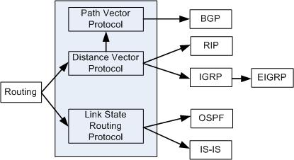
Routing in Traditional Networks
There are two types of routing method, one is distance vector and the other one is link state.
[61] http://www.tonypickett.com/2013/07/routing-protocols-overview/

Slide 66
Routing in SDN
Depends on controller
If we want to implement traditional routing method, we need to write them one by one on each kind of controllers.
RouteFlow is an interface that can help Openflow controllers to do routing. (OSPF, BGP, RIP, etc.)

Slide 67
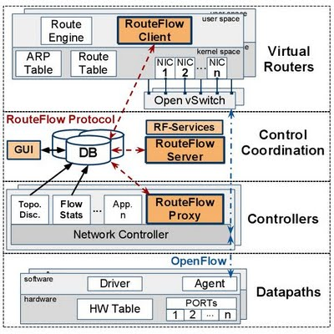
RouteFlow
Add Route Flow
proxy on controllers.
Let controllers to do
traditional routing method.
[62] https://sites.google.com/site/routeflow/

Slide 68
Management Plane
Network management of traditional network
Network management of SDN
OpenFlow Configuration and Management Protocol (OF-CONFIG)

Slide 69
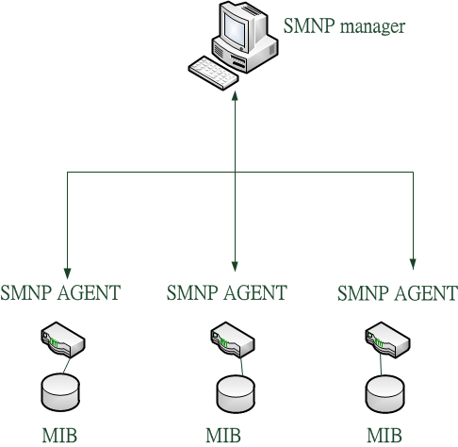
Network Management in Traditional networks
SNMP (Simple Network Management Protocol)

Slide 70
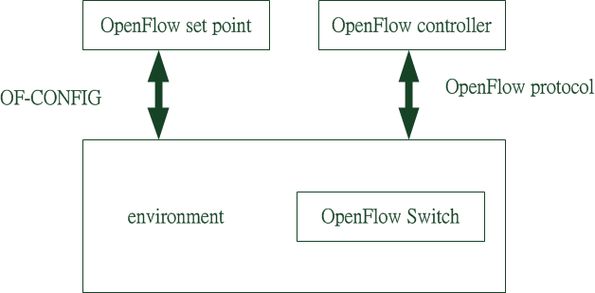
Network Management in SDN

Slide 71
OpenFlow Configuration and Management Protocol (OF-CONFIG)
A set of rules to access and modify configuration data on an OpenFlow switch.
Allocate ports and assign IP addresses

Slide 72
OF-CONFIG vs. SNMP
 | OF-CONFIG | Traditional networks
Protocol | NETCONF | SNMP
Functionality | Configure tunnels Set port parameters Turn ports off and on Retrieve switch status | Fault Management Configuration Management Performance Management Accounting Management Security Management
Communicate method | Transmit XML file | Transmit command
Message | OpenFlow Capable Switch OpenFlow Configuration Point OpenFlow Logical Switch Logical Switch Capabilities OpenFlow Controller OpenFlow Resource OpenFlow Port OpenFlow Port Feature OpenFlow Queue (All of these are XML file) | GetRequest GetNextRequest GetResponse SetRequest Trap

Slide 73
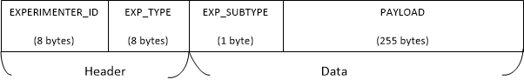
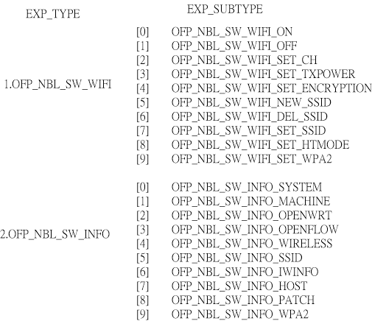
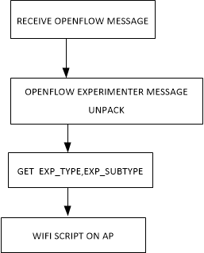
Introduction to OpenFlow extension

Slide 74
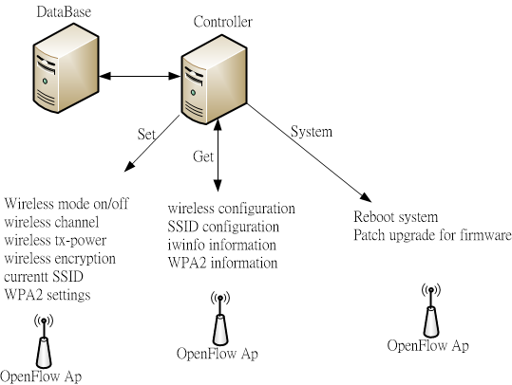
Wi-Fi Configuration

Slide 75
Case Study Campus Wi-Fi SDN solution
Functional specification
Architecture design

Slide 76

Features vs. Components
 | SDN Controller App | SDN Access Point | OAM Web System
System Management
Generic Wireless Control
Device Description Retrieval
Auto Provision Function
Channel Non-overlapping Function
MAC Address Filter Control
Local Service Management
Diagnostic Function
Device Status Retrieval
Device Logging Retrieval
Roaming
Authentication Portal Function
Quality of Service
76

Slide 77
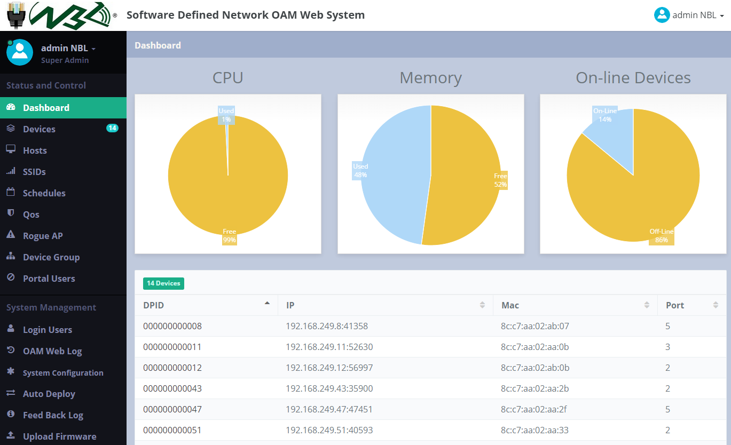
SDN Wi-Fi OAM
Centralized OAM with user friendly Web UI
Easy to maintain and will support multiple controllers

Slide 78
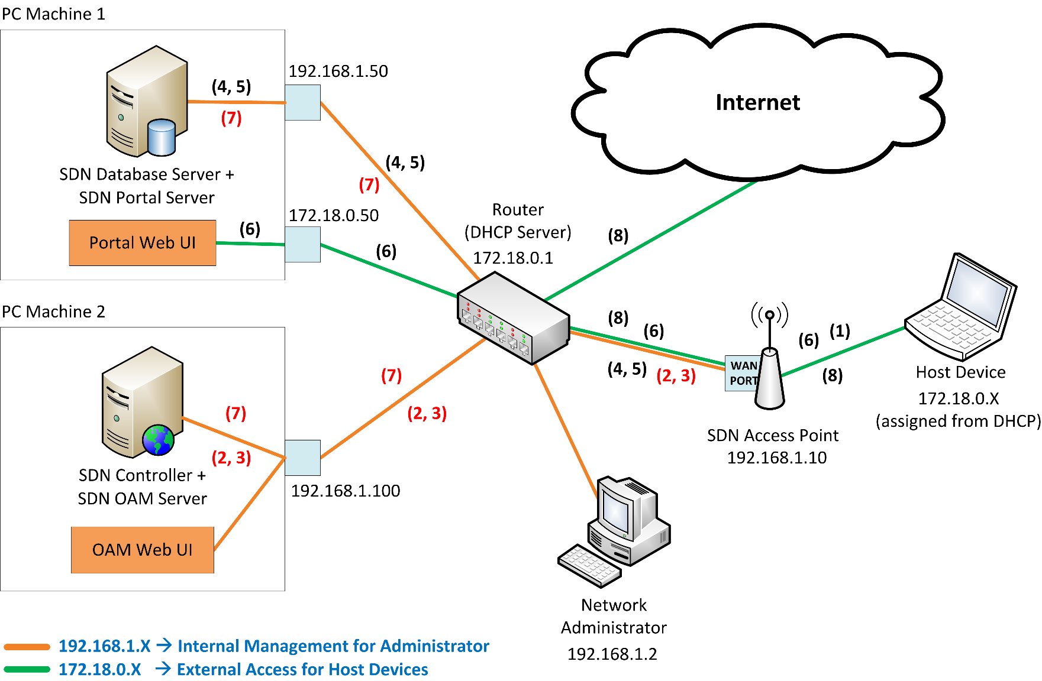
Architecture Design (Beta Site)
Controller: VM server
Portal: VM server
Router/NAT: Draytek
SDN AP: TP-Link, EstiNet

Slide 79
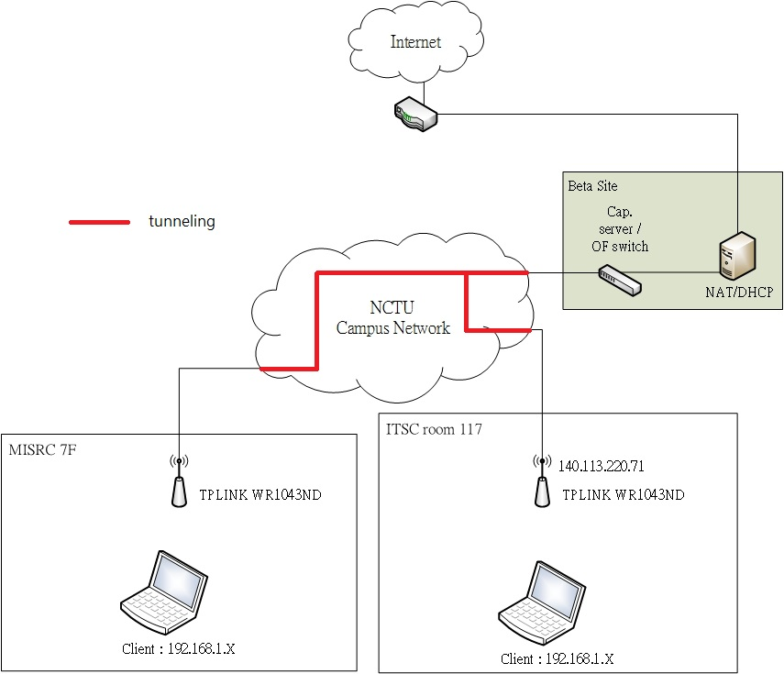
Architecture Design (Campus Network)
OFSwitch: arista7050
NAT: Tplink 1043ND

Slide 80
Testing

Slide 81
Resources for Testers
Tool | Purpose | Reference
Mininet | Generate topology and simulate network behavior
OpenFlowVMs | Connect VM to openflow network
Openflow Conformance Test Plan | Conformance test | [63]
NICE | Auto testing tool for OpenFlow application | [64]
NDB | Network debugger (1)break point (2)packet back trace | [65][66]
OFLOPS | OpenFlow testing platform | [67]

Slide 82
Test Tools
Company | Product | Functional | Conformance | Performance | Negative testing
Spirent | TestCenter OpenFlow | O |  | O
 | TestCenter |  | O
 | Spirent Avalanche |  |  | O
 | TestCenter Virtual & Avalanche Virtual |  |  | O
Ixia | IxANVL |  | O
 | IxNetwork | O |  | O | O
Codenomicon | OpenFlow Controller Test Suite |  |  |  | O
 | OpenFlow Switch Test Suite |  |  |  | O

Slide 83
ONF Conformance Test Items
 | Test item | Example
Basic | Basic Sanity Checks | Connection test
 | Basic OpenFlow protocol messages | FEATURES REQUEST
 | Spanning Tree | Building spanning tree
In switch | Flow Matching | All wildcard
 | Counters | Received packets
 | Actions | FORWARD
Controller to switch | Flow modification messages | Delete flows
Switch to controller | Async Messages | OFPT_PORT_STATUS
Bidirection | Messages | OFPT_HELLO
 | Error Messages | OFPBRC_BAD_VERSION

Slide 84
Testing Methodologies: Lab Test
Lab test
App, Controller | Functionality Unit-function test Multi-function integration test Flow entry/table conflict control Error tolerance
App, Cloud Service | Performance Congestion control QoS control Loading Balance Tunneling Migration
Controller, Network devices | Functionality Spec verification Unit-function test Multi-function integration test Conformance OpenFlow 1.3 OpenFlow 1.4 conformance test Interoperability OpenFlow 1.0, 1.3 Interoperability

Slide 85
Testing Methodologies: Field Test
Filed test
Field trial control system | DUT/SUT registration and discovery Controller registration App registration and on/off shelf control Topology generator Integrated SDN and non-SDN
Defect collector for reproduce mechanism | Auto topology generator for DUT/SUT to register and integrated with SDN and non-SDN Monitor system for collecting information from all components Clients simulator for reproduction defect Trackable packets/flows technology

Slide 86
Testing Methodologies: Automatic Testing Tools
Auto testing tool
Conformance Test | OpenFlow 1.3 OpenFlow 1.4
Performance Test | Flow/Group/Meter entry/table performance test
Stateful Defect Replayer | GUI based flow/traffic tracker with topology generator modified by open source controller Combined with simulated network device to compare with the related tables Client simulator and trackable packet generator modified by open source controller and scriptable packet/traffic generator Replayer to replay the status of each component

Slide 87
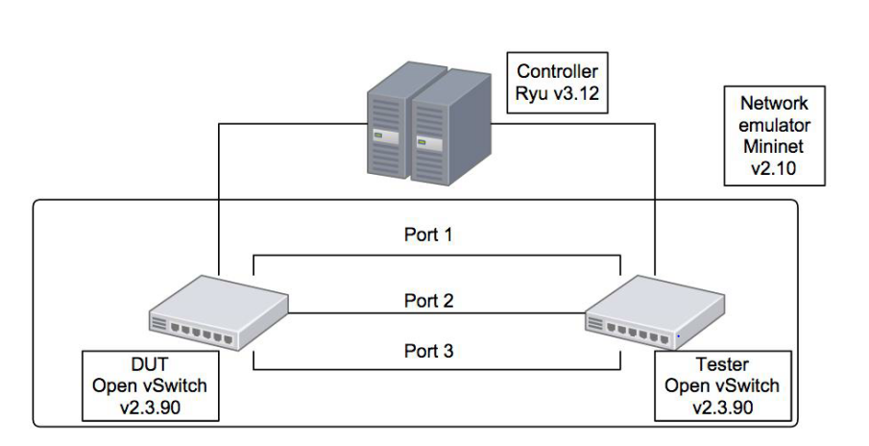
Testing Environment

Slide 88
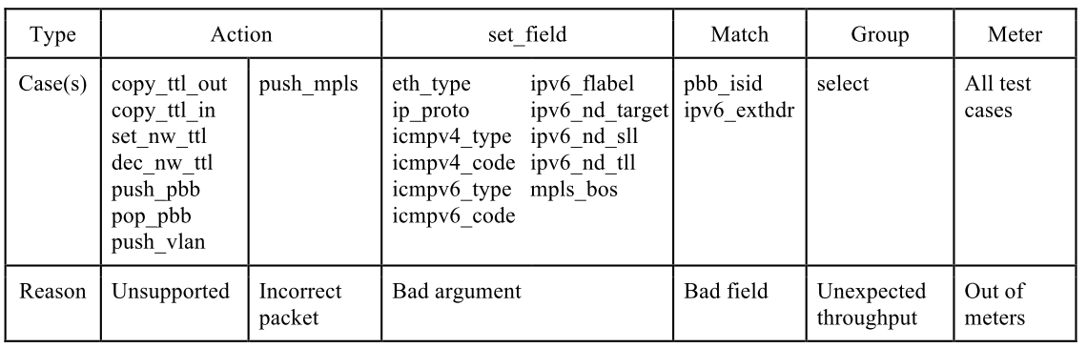
Fail to Pass: Testing Items

Slide 89
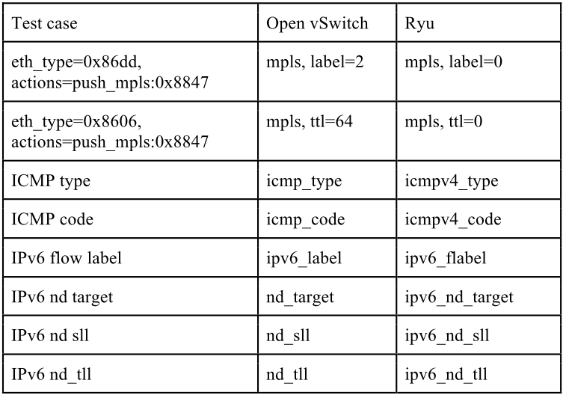
Implementation Differences between Open vSwitch and Ryu

Slide 90
Lessons Learned (1/2)
SDN vs. NFV
NFV enjoys better growth: no new protocols
NFV /wo SDN → SDN /wo NFV → SDN /w NFV (SDNFV)
SDN-NFV killer apps
SDN: SD-WAN → MEC?
NFV: vDNS, vAAA, vIMS → vEPC, vCPE, vFW → vRAN, vMEC, vUTM?
Virtualization game: communications → computing
Which? Less time-critical parts
Where? Google vs. operators: similar to CDN
AT&T CORD: Enterprise → Residential → Mobile
Who?
Broadcom/Qualcomm vs. Intel/ARM
Cisco vs. two lines of competitors
Existing vendors and startups: OpenDaylight vs. ONOS
Operators: AT&T, Verizon, NTT, etc.

Slide 91
Lessons Learned (2/2)
Business model reorg
Boxes/hardware → services/software
Vendor-driven → operator-driven
Operator’s dilemma: Build or buy
Black-box → grey-box → white-box?
Open source projects: ONOS, OpenStack, etc.
MANO (Management and Organization): orchestration and management
App matrix
Appliances to apps
100 x 3~5
Tons of research, plus business opportunities, await us.
OpenFlow switch design: multi-table, load balancing, etc.
SDN-NFV security
SDN-NFV in Wi-Fi, 5G small cells, IoT
SD-WAN, vCPE, vEPC, vMME, vMEC, vSecurity, vANYTHING
SDN-NFV modeling and analysis

Slide 92
References (1/7)
[1] | E. Al-Shaer and S. Al-Haj, “FlowChecker: Conﬁguration analysis and veriﬁcation of federated OpenFlow infrastructures,” in Proc. 3rd ACM Workshop SafeConﬁg., 2010, pp. 37–44.
[2] | R. McGeer, “Verification of switching network properties using satisfiability,” in Proc. IEEE ICC,2012,pp. 6638-6644
[3] | R. W. Skowyra, A. Lapets, A. Bestavros, and A. Kfoury, “Veriﬁably-safe software-deﬁned networks for CPS,” in Proc. 2nd ACM Int. Conf. High Conﬁdence Netw. Syst., 2013, pp. 101–110.
[4] | A. Khurshid, W. Zhou, M. Caesar, and P. B. Godfrey, “Ver-iFlow: Verifying Network-Wide Invariants in Real-Time,” in Proceedings of the first workshop on Hot topics in softwaredefined networks, ser. HotSDN ’12.ACM, 2012, pp. 49–54.
[5] | P. Kazemian, M. Chang, H. Zeng, G. Varghese, N. McKeown,and S. Whyte, “Real Time Network Policy Checking Using Header Space Analysis,” in Proceedings of the 10th USENIX Conference on Networked Systems Design and Implementa-tion, ser. nsdi’13. Berkeley, CA, USA: USENIX Association,2013, pp. 99–112.
[6] | M. Canini, D. Venzano, P. Pere?s´ini, D. Kosti´c, and J. Rexford,“A NICE way to Test OpenFlow Applications,” in Proceedings of the 9th USENIX conference on Networked Systems Design and Implementation, ser. NSDI’12.USENIX Association, 2012, pp. 10–10.
[7] | M. Kuzniar, M. Canini, and D. Kostic, “OFTEN Testing OpenFlow Networks,” in the Proceedings of the 2012 European Workshop on Software-Defined Networking, ser. EWSDN ’12.Washington, DC, USA: IEEE Computer Society, 2012, pp. 54–60.
[8] | N. Kang, Z. Liu, J. Rexford, and D. Walker, “Optimizing the “One Big Switch” Abstraction in Software-Defined Networks,” in Proceedings of the 9th international conference on Emerging networking experiments and technologies, ser. CoNEXT ’13. New York, NY, USA: ACM, 2013.

Slide 93
References (2/7)
[9] | J. Wang, Y. Wang, H. Hu, Q. Sun, H. Shi, and L. Zeng, “To-wards a Security-Enhanced Firewall Application for OpenFlow Networks,” in Cyberspace Safety and Security. Springer, 2013,pp. 92–103.
[10] | S. Son, S. Shin, V. Yegneswaran, P. Porras, and G. Gu, “Model Checking Invariant Security Properties in OpenFlow,” in Proceedings of 2013 IEEE International Conference on Communications (ICC’13), June 2013.
[11] | M. Reitblatt, N. Foster, J. Rexford, and D. Walker, “Consis-tent Updates for Software-Defined Networks: Change You Can Believe in!” in Proceedings of the 10th ACM Workshop on HotTopics in Networks, ser. HotNets-X.ACM, 2011, pp. 7:1–7:6.
[12] | M. Reitblatt,N.Foster,J.Rexford,C.Schlesinger,and D.Walker,“Abstractions for Network Update,” in Proceedings of the ACM SIGCOMM 2012 conference on Applications,technologies, architectures, and protocols for computer commu-nication, ser. SIGCOMM ’12. New York, NY, USA:2012, pp. 323–334.
[13] | J. Naous, D. Erickson, G. A. Covington, G. Appenzeller, and N. McKeown, “Implementing an OpenFlow Switch on the NetFPGA Platform,” in Proceedings of the 4th ACM/IEEE Symposium on Architectures for Networking and Communi-cations Systems, ser. ANCS’08. New York, NY, USA: ACM, 2008, pp. 1–9.
[14] | Y. Luo, P. Cascon, E. Murray, and J. Ortega, “Accelerating OpenFlow Switching with Network Processors,” in the Pro-ceedings of the 5th ACM/IEEE Symposium on Architectures for Networking and Communications Systems, ser. ANCS ’09. New York, NY, USA: ACM, 2009, pp. 70–71.
[15] | V. Tanyingyong, M. Hidell, and P. Sjodin, “Using Hardware Classification to Improve PC-based OpenFlow Switching,” in IEEE 12th International Conference on High Performance Switching and Routing (HPSR), 2011, pp. 215–221.

Slide 94
References (3/7)
[16] | R. Narayanan, S. Kotha, G. Lin, A. Khan, S. Rizvi, W. Javed, H. Khan, and S. Khayam, “Macroflows and Microflows: En-abling Rapid Network Innovation through a Split SDN Data Plane,” in European Workshop on Software Defined Network-ing (EWSDN), 2012, pp. 79–84.
[17] | G. Lu, R. Miao, Y. Xiong, and C. Guo, “Using CPU as a Tra?c Co-Processing Unit in Commodity Switches,” in the Proceedings of the first workshop on Hot Topics in Software Defined Networks, ser. HotSDN ’12. New York, NY, USA: ACM, 2012, pp. 31–36.
[18] | N. Kang, Z. Liu, J. Rexford, and D. Walker, “Optimizing the “One Big Switch” Abstraction in Software-Defined Networks,” in Proceedings of the 9th international conference on Emerging networking experiments and technologies, ser. CoNEXT ’13. New York, NY, USA: ACM, 2013.
[19] | Sandra Scott-Hayward, “A Survey of Security in Software Deﬁned Networks”, , IEEE Communications Surveys & Tutorials
[20] | D. Yu, A. W. Moore, C. Hall, and R. Anderson, Authentication for Resilience: The Case of SDN, ser. Security Protocols XXI. Springer,2013, pp. 39–44.
[21] | X. Wen, Y. Chen, C. Hu, C. Shi, and Y. Wang, “Towards a secure controller platform for openﬂow applications,” in Proceedings of the second ACM SIGCOMM workshop on Hot topics in software deﬁned networking. ACM, 2013, pp. 171–172.
[22] | S. Scott-Hayward, C. Kane, and S. Sezer, “OperationCheckpoint:SDN Application Control,” in 22nd IEEE International Conference on Network Protocols (ICNP). IEEE, 2014, pp. 618–623.
[23] | D. M. F. Mattos, L. H. G. Ferraz, and O. C. M. B. Duarte, “AuthFlow:Authentication and Access Control Mechanism for Software Deﬁned Networking.”
[24] | P. Porras, S. Shin, V. Yegneswaran, M. Fong, M. Tyson, and G. Gu, “A security enforcement kernel for OpenFlow networks,” in Proceedings of the ﬁrst workshop on Hot topics in software deﬁned networks. ACM,2012, pp. 121–126.
[25] | S. Shin, Y. Song, T. Lee, S. Lee, J. Chung, P. Porras, V. Yegneswaran, J. Noh, and B. B. Kang, “Rosemary: A Robust, Secure, and High-Performance Network Operating System,” in Proceedings of the 2014 ACM SIGSAC Conference on Computer and Communications Security. ACM, 2014, pp. 78–89.

Slide 95
References (4/7)
[26] | S. Shin, V. Yegneswaran, P. Porras, and G. Gu, “AVANT-GUARD:scalable and vigilant switch ﬂow management in software-deﬁned networks,” in Proceedings of the 2013 ACM SIGSAC conference on Computer & Communications Security. ACM, 2013, pp. 413–424.
[27] | G. Yao, J. Bi, and P. Xiao, “Source address validation solution with OpenFlow/NOX architecture,” in 19th IEEE International Conference on Network Protocols (ICNP). IEEE, 2011, pp. 7–12.
[28] | J. Naous, R. Stutsman, D. Mazieres, N. McKeown, and N. Zeldovich, “Delegating network security with more information,” in Proceedings of the 1st ACM workshop on Research on enterprise networking. ACM, 2009, pp. 19–26.
[29] | M. Canini, D. Venzano, P. Peresini, D. Kostic, and J. Rexford, “A NICE way to test OpenFlow applications,” in Proceedings of the 9th USENIX conference on Networked Systems Design and Implementation, 2012.
[30] | E. Al-Shaer and S. Al-Haj, “FlowChecker: Conﬁguration analysis and veriﬁcation of federated OpenFlow infrastructures,” in Proceedings of the 3rd ACM workshop on Assurable and usable security conﬁguration. ACM, 2010, pp. 37–44.
[31] | S. Son, S. Shin, V. Yegneswaran, P. Porras, and G. Gu, “Model Checking Invariant Security Properties in OpenFlow.” [Online]. Available: http://faculty.cse.tamu.edu/guofei/paper/Flover-ICC13.pdf
[32] | N. Foster, R. Harrison, M. J. Freedman, C. Monsanto, J. Rexford, A. Story, and D. Walker, “Frenetic: A network programming language,” ACM SIGPLAN Notices, vol. 46, no. 9, pp. 279–291, 2011.
[33] | J. Wang, Y. Wang, H. Hu, Q. Sun, H. Shi, and L. Zeng, Towards a Security-Enhanced Firewall Application for OpenFlow Networks, ser. Cyberspace Safety and Security. Springer, 2013, pp. 92–103.
[34] | H. Hu, G.-J. Ahn, W. Han, and Z. Zhao, “Towards a Reliable SDN Firewall,” Presented as part of the Open Networking Summit 2014(ONS 2014), 2014.
[35] | F. A. Botelho, F. M. V. Ramos, D. Kreutz, and A. N. Bessani, “On the feasibility of a consistent and fault-tolerant data store for SDNs,” in Software Deﬁned Networks (EWSDN), 2013 Second European Workshop on. IEEE, 2013, pp. 38–43.
[36] | C. Schlesinger, A. Story, S. Gutz, N. Foster, and D. Walker, “Splendid Isolation: Language-Based Security for Software-Deﬁned Networks,” in Proceedings of the ﬁrst workshop on Hot topics in software deﬁned networks. ACM, 2012, pp. 79–84.

Slide 96
References (5/7)
[37] | N. Handigol, B. Heller, V. Jeyakumar, D. Mazieres, and N. McKeown, “Where is the debugger for my software-deﬁned network?” in Proceed-ings of the ﬁrst workshop on Hot topics in software deﬁned networks. ACM, 2012, pp. 55–60.
[38] | S. Shin, P. Porras, V. Yegneswaran, M. Fong, G. Gu, and M. Tyso, “FRESCO: Modular composable security services for software-deﬁned networks,” in Proceedings of Network and Distributed Security Sym-posium, 2013.
[39] | J. Matias, E. Jacob, D. Sanchez, and Y. Demchenko, “An OpenFlow-Based Network Virtualization Framework for the Cloud,” in Cloud Computing Technology and Science (Cloud-Com), 2011 IEEE Third International Conference on, 2011,pp. 672–678.
[40] | L. Sun, K. Suzuki, C. Yasunobu, Y. Hatano, and H. Shimon-ishi, “A Network Management Solution Based on OpenFlow Towards New Challenges of Multitenant Data Center,” in Information and Telecommunication Technologies (APSITT),2012 9th Asia-Pacific Symposium on, 2012, pp. 1–6.
[41] | M. Mendonca, K. Obraczka, and T. Turletti, “The Case for Software-Defined Networking in Heterogeneous Networked En-vironments,” in Proceedings of the 2012 ACM conference on CoNEXT student workshop, ser. CoNEXT Student ’12.York, NY, USA: ACM, 2012, pp. 59–60.
[42] | K.-K. Yap, M.Kobayashi,R.Sherwood,T.-Y.Huang,M.Chan,N.Handigol, and N. McKeown, “OpenRoads: em-powering research in mobile networks,” SIGCOMM Comput.Commun. Rev., vol. 40, no. 1, pp. 125–126, Jan. 2010.
[43] | N. Blefari-Melazzi, A. Detti, G. Morabito, S. Salsano,L. Veltri, “Information Centric Networking over SDN and OpenFlow: Architectural Aspects and Experiments on OFELIA Testbed,” CoRR, vol. abs/1301.5933, 2013.
[44] | D. Syrivelis, G. Parisis, D. Trossen, P. Flegkas, V. Sourlas,T. Korakis, and L. Tassiulas, “Pursuing a Software Defined Information-Centric Network,”in Software Defined Networking(EWSDN), 2012 European Workshop on, 2012, pp. 103–108.
[45] | Open Networking Foundation, “Network Functions Virtualisa-tion. An Introduction, Benefits, Enablers, Challenges and Call for Action,” http://portal.etsi.org/NFV/NFV/pdf/, NFV Industry Specification Group, Tech. Rep., October 2012, nFV white paper.
[46] | D. Drutskoy, E. Keller, and J. Rexford, “Scalable Network Virtualization in Software-Defined Networks,” Internet Com-puting, IEEE, vol. 17, no. 2, pp. 20–27, 2013.

Slide 97
References (6/7)
[47] | S. Shin, V. Yegneswaran, P. Porras, and G. Gu, “AVANT-GUARD: Scalable and Vigilant Switch Flow Management in Software-defined Networks,” in Proceedings of the 2013 ACMSIGSAC Conference on Computer; Communications Security, ser. CCS ’13. New York, NY, USA: ACM, 2013, pp. 413–424.
[48] | P. Porras, S. Shin, V. Yegneswaran, M. Fong, M. Tyson, and G. Gu, “A Security Enforcement Kernel for OpenFlow Net-works,” in Proceedings of ACM SIGCOMM Workshop on Hot Topics in Software Defined Networking (HotSDN’12), August 2012.
[49] | http://osrg.github.io/ryu/
[50] | http://ryu.readthedocs.org/en/latest/
[51] | http://blog.xuite.net/juilin77/happy/202669918-%E5%BF%AB%E5%BF%AB%E6%A8%82%E6%A8%82%E5%AE%89%E8%A3%9DRYU+%26+RYU+GUI
[52] | https://github.com/yamada-h/ryu/wiki/GUI
[53] | https://github.com/MeshSr/ofsoftswitch
[54] | http://mininet.org/walkthrough/
[55] | https://sites.google.com/site/sdnruantidingyiwanglu/mininet
[56] | http://blog.disects.com/2014/01/installing-cpqd-switch-on-mininet-using.html
[57] | http://br1.einfach.org/gitweb?p=horst;a=summary

Slide 98
References (7/7)
[58] | http://br1.einfach.org/2010/12/spectrum-analyzer-for-horst/
[59] | http://blog.csdn.net/yahohi/article/details/6579599
[60] | https://openflow.stanford.edu/display/ONL/POX+Wiki#POXWiki-ComponentsinPOX
[61] | http://www.tonypickett.com/2013/07/routing-protocols-overview/
[62] | https://sites.google.com/site/routeflow/
[63] | http://www.opennetworking.org/
[64] | Canini, M., Venzano, D., Peresini, P., Kostic, D., & Rexford, J. (2012). A NICE way to test OpenFlow applications. NSDI, Apr.
[65] | Handigol, N., Heller, B., Jeyakumar, V., Mazières, D., & McKeown, N. (2012, August). Where is the debugger for my software-defined network?. In Proceedings of the first workshop on Hot topics in software defined networks (pp. 55-60). ACM.
[66] | Kuzniar, M., Peresini, P., Canini, M., Venzano, D., & Kostic, D. (2012, December). A SOFT way for openflow switch interoperability testing. In Proceedings of the 8th international conference on Emerging networking experiments and technologies (pp. 265-276). ACM.
[67] | Rotsos, C., Sarrar, N., Uhlig, S., Sherwood, R., & Moore, A. W. (2012, January). Oflops: An open framework for openflow switch evaluation. In Passive and Active Measurement (pp. 85-95). Springer Berlin Heidelberg.
[68] | SDN dummy pack : https://drive.google.com/a/g2.nctu.edu.tw/folderview?id=0By7OPNojKY8yfkxITmhNZEY2SE9UWU9rSVNidWkzR0JDaUlwS3FTVG1VX0RYdHFQMVQ1OUE&usp=sharing#

